Slide 1
Sloj mreže
Network layer
Radisavljević Veljko

Slide 2
Transport layer
Application
Presentation
Session
Transport
Network
Data link
Physical
Segment
👈
📦
👈
Seq.
Num.
Port
Num.
👈
👉
Source
Destination
👈

Slide 3
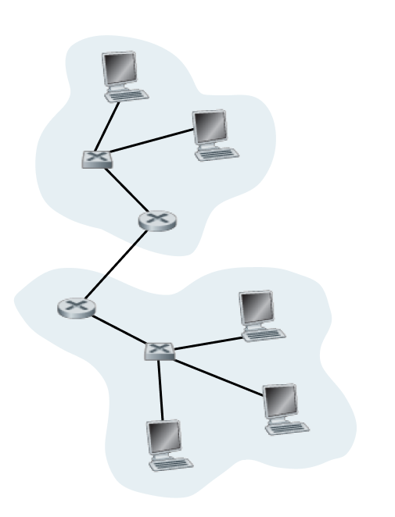
Network layer
Application
Presentation
Session
Transport
Network
Data link
Physical
👈

Slide 4
Funkcije
Logical
Addressing
Path
Determination
Routing
Šta je?
Kako radi?
IPv4
IPv6
Subnet Mask
OSPF
BGP
IS-IS

Slide 5

Logical Addressing
IPv4 👴
IPv6 👶
32-bit
numeric (0-9)
128-bit
hexadecimal (0-F)
4 Billion
👈
320 undecillion
👈
👉
192.168.7.37
34CF:64BC
👈
👈
👉
Subnet
Mask

Slide 6
Subnet Mask
👈
🖥️
👉
👈
👉
IP Address
Mask
192.168.1.19
bin
👉
255.255.255.0
👉
👉
11111111.11111111.11111111.00000000
👈
1 = Network bits
0 = Host bits
👉
👈
1 1 1 1 1 1 1 1
128 64 32 16 8 4 2 1

Slide 7
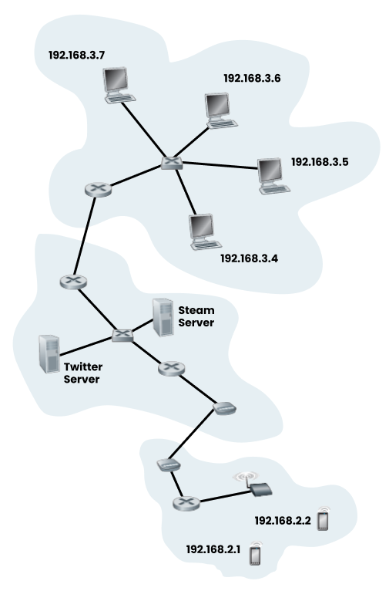
Routing
👉
👉
👈
Source
👉
Destination
👉
👉
👈
👉
Network
👈
👉
Host
👉
👈

Slide 8
Path Determination
OSPF
BGP
Šta je?
Čemu služi?
Kako radi?
Šta je?
Čemu služi?
Kako radi?
IS-IS
Šta je?
Čemu služi?
Kako radi?

Slide 9
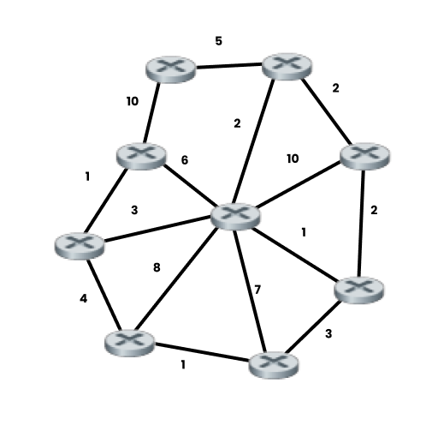
OSPF
👉
👈
📝
📝
OSPF
👉
👈
📝
Open Shortest Path First
👉
📝
👈
📝
👉
Link State
👈
📝
LSA - Link State Advertisement
👈
👉
📝
LSDB - Link State Database 📝
👈
📝
📝
👈
Cost:
👉
👉
1 💪
👈
👈
10 💪
👉

Slide 10
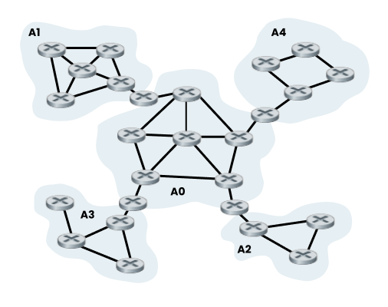

OSPF Areas
👑
👉
👉
Žašto Areas?
👉
👈
Backbone
👉
ABR - Area Border Router 💪
👉
👈

Slide 11
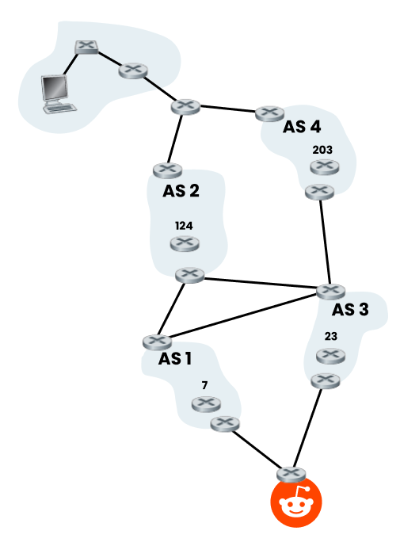
BGP
BGP
Border Gateway Protocol
👈
Weight
Local Preferences
Origin
AS-path
Origin code
MED (Multi-Exit Discriminator)
eBGP over iBGP Path
Shortest IGP Path
BGP Multipath
Prefer Oldest Path
Lowest Router ID
Shortest Cluster-List
👉
👉
👈

Slide 12
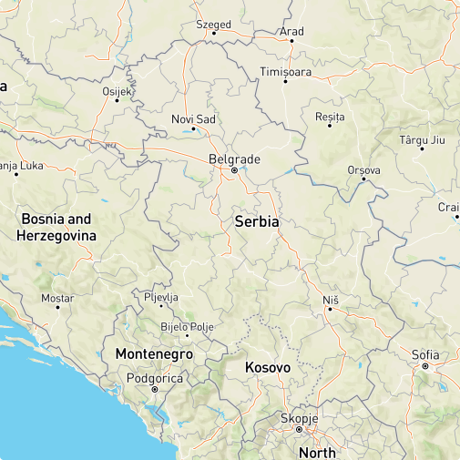
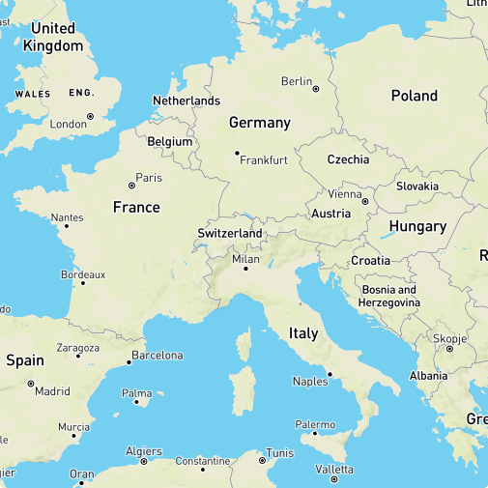
OSPF vs BGP
OSPF
BGP

Slide 13
Hvala na pažnji

